Slide 1

Mahatma Gandhi Central University,
Motihari
ANALYSIS OF TIME SERIES (Netflix) DATA
Submitted By:​
Sakshi & Prince
MGCU2021CSIT3022 / 3014
Submitted To:​
Dr. Vipin Kumar​
Assistant Professor​

Slide 2
CONTENT
Problem Definition
Data Description
Methodology
Exploratory Data Analysis
Model Comparison
Hybrid deep learning model
Comparative analysis
Result
Conclusion
Reference

Slide 3
Problem Definition
Find any kind of time series data.
Do the exploratory analysis of the same.
Apply statistical models and deploying the deep learning models like GRU ,CNN, RNN, LSTM and BiLSTM and compare it based on various performance measures.
Plot the above as line, scattered, boxplot , bar plot etc. of the top five models based on used data.
Compare the previous statistical models and deep learning models and plot for further comparative analysis.

Slide 4
Data Description
Stock price of Netflix from 05/02/18 to 04/02/22.
https://drive.google.com/file/d/1nD_bEUHKjIwVaRmttk43bbsyxZyr83eo/view?usp=drive_link

Slide 5
Methodology
Model Selection
This could include traditional statistical models like ARIMA, or more advanced machine learning models like neural network
Preprocessing:
•This may involve handling missing values, dealing with outliers, and addressing any necessary data transformations such as scaling or differencing.
Train-Test Split:
•Split the time series data into training and testing sets
•Evaluate the trained models using appropriate evaluation metrics such as MAE, RMSE, or MAPE.
•Iteratively refine the methodology by experimenting with different models, preprocessing techniques, or feature engineering approaches to improve the forecasting performance.

Slide 6
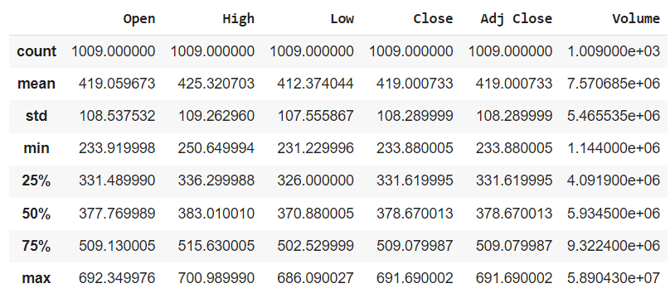
Exploratory Data Analysis
Explorality Data Analysis

Slide 7
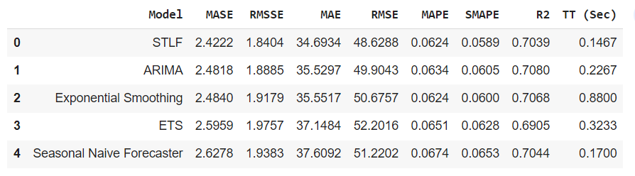
Top 5 Statistical Model Comparison

Slide 8
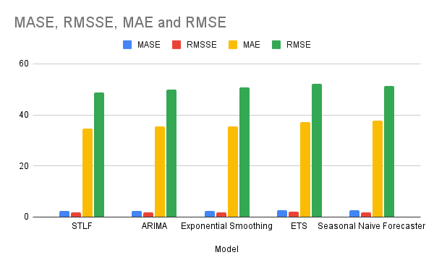

Slide 9
Diving into Deep Learning
Deep learning is a subset of machine learning that utilizes neural networks with multiple layers to learn and extract complex patterns from data.

Slide 10
Deep Learning Models Applied on the Data
Convolutional LSTM
CNN (Convolutional Neural Network)
RNN (Recurrent Neural Network)
GRU (Gated Recurrent Unit)
LSTM (Long Short-Term Memory Networks)
Hybrid Model

Slide 11
Models, Their Prediction & RMSE
Models | Predicted Values | RMSE
ConvLSTM | 413.51105 | 12.634795666073808
CNN | 425.5489 | 13.073817264899207
RNN | 32.619453 | 401.5667947241156
GRU | 406.42978 | 11.071402722869092
LSTM | 406.08997 | 11.063379629907365
Hybrid | 406.90198 | []

Slide 12
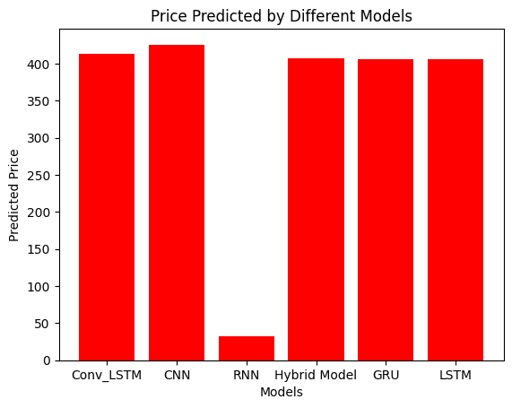
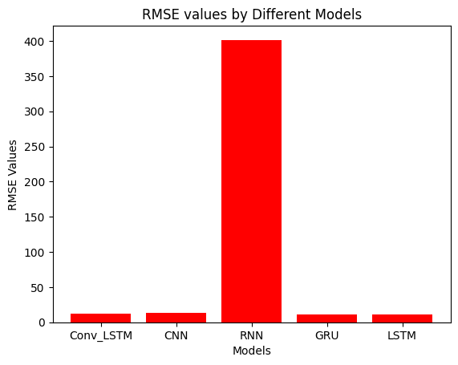
Models, Their Prediction & RMSE

Slide 13
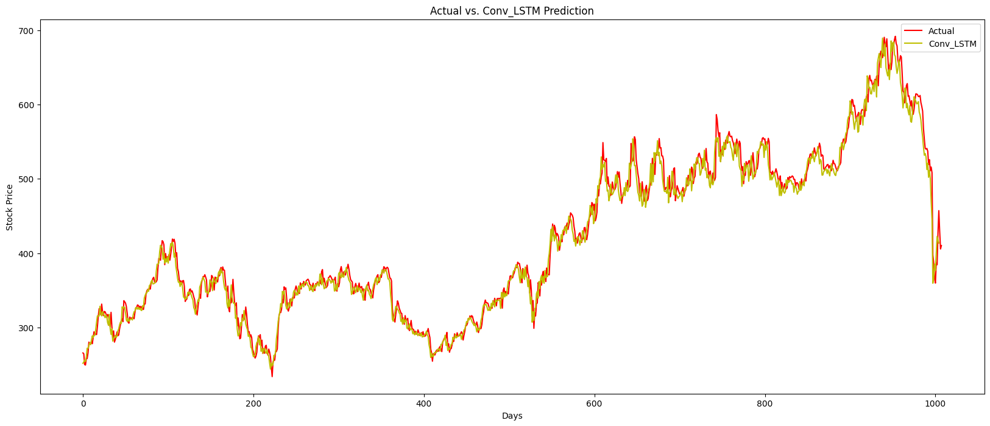
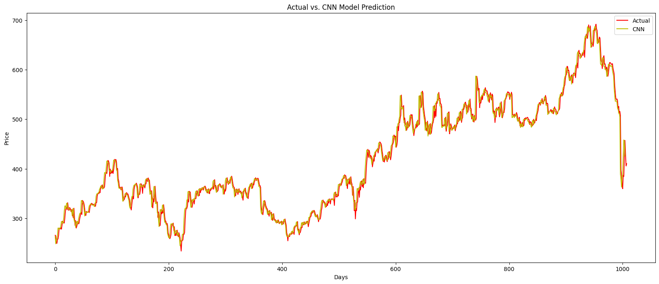
Visualise the Comparison

Slide 14
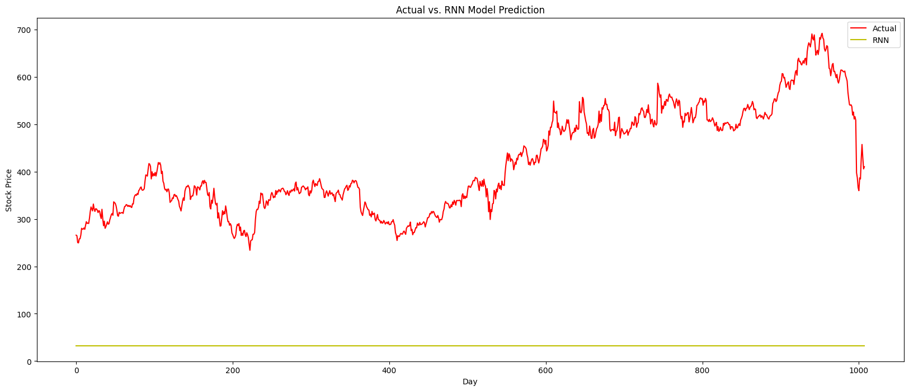
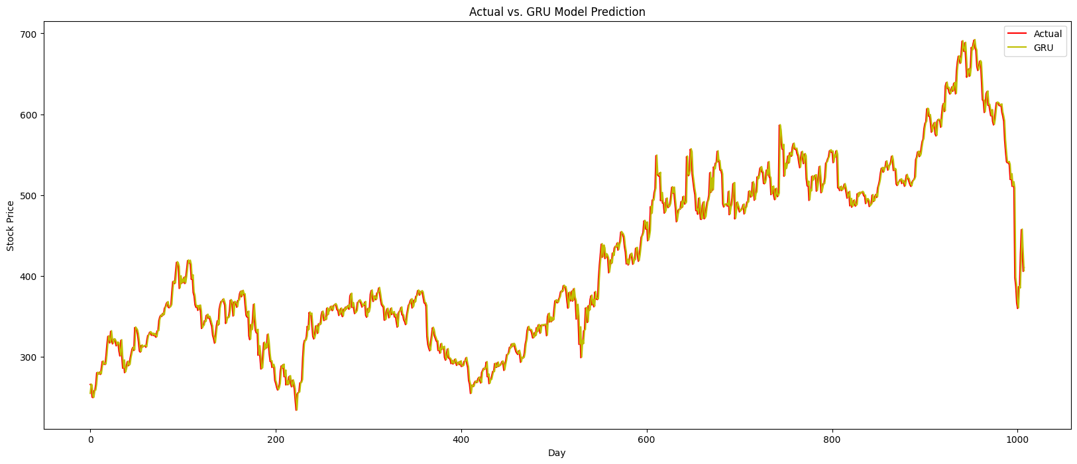
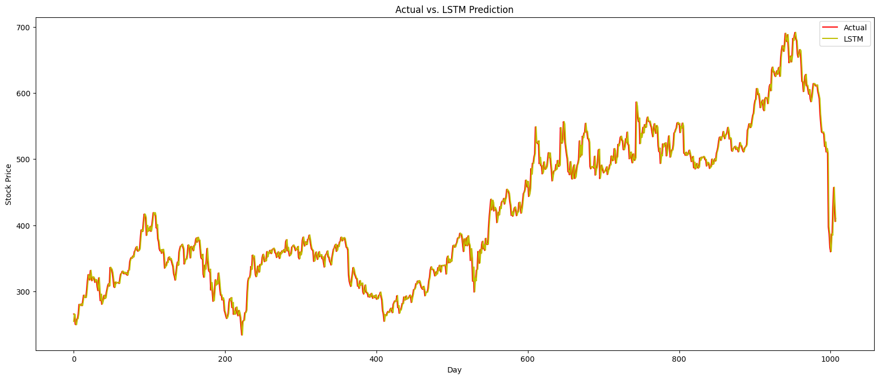
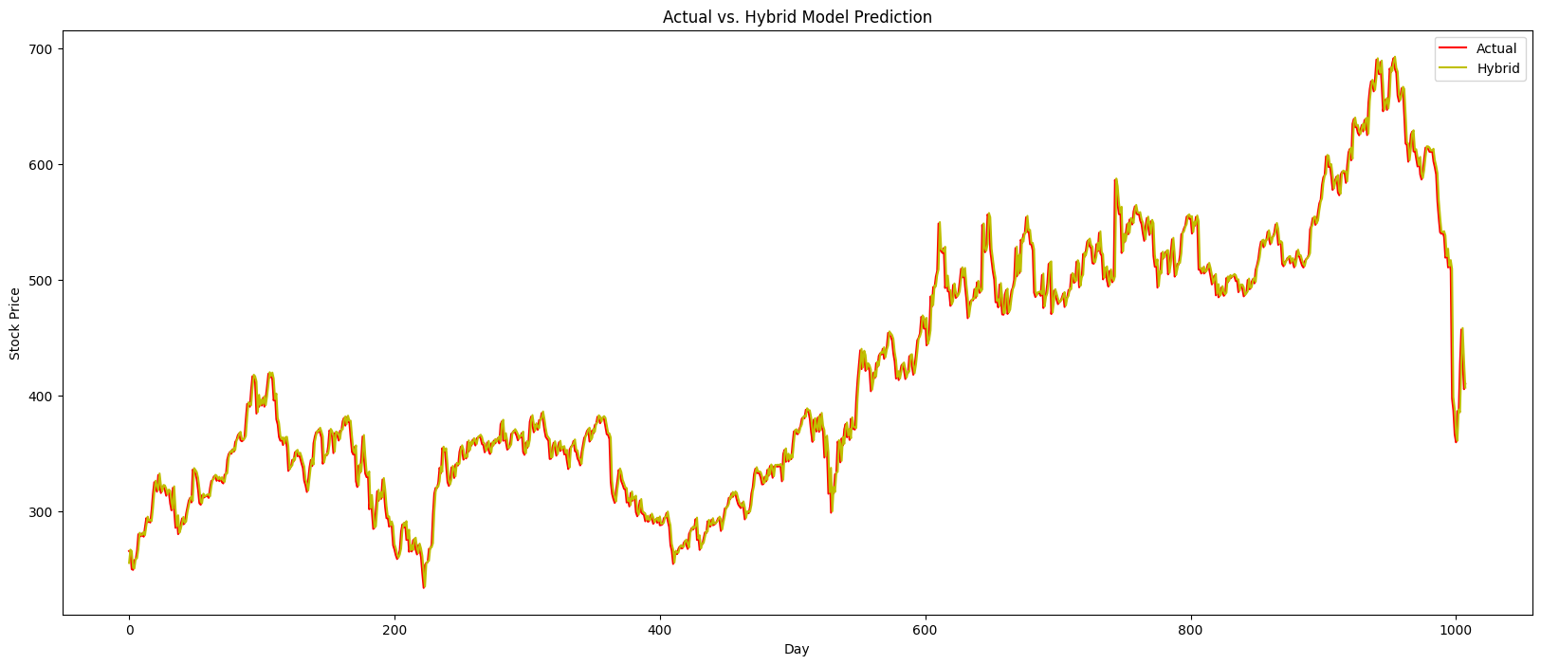

Slide 15
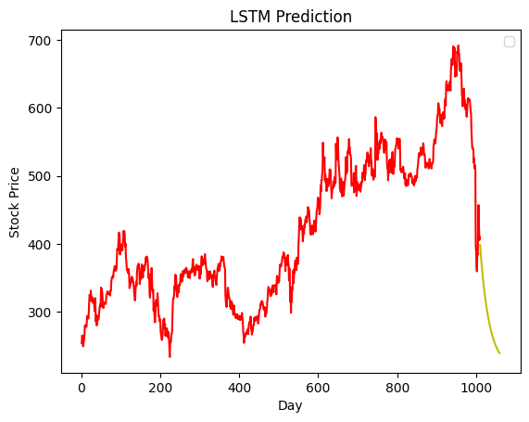
LSTM Prediction

Slide 16
Result
Mean of the Data - 419.000733
Best Statistical Model - STLF
Best Deep Learning Model - LSTM
Best RMSE value - 11.063379629907365(LSTM)

Slide 17
Conclusion
By doing the statistical analysis, we came to know that STLF (Seasonal Naive Decomposition using Loess Forecasting) is the most suitable model for our data with RMSE value - 48.6288.
On applying deep learning models, LSTM emerged as the best model among Conv_LSTM, CNN, RNN, GRU, LSTM, and Hybrid model with RMSE value - 11.063379629907365.
Deep learning Models predicted well over the statistical models.

Slide 18
Reference
https://www.kaggle.com/datasets/shenba/time-series-datasets
https://chat.openai.com/
https://scikit-learn.org/stable/
https://pycaret.org/
https://practice.geeksforgeeks.org/
https://github.com/
https://pypi.org/project/sktime/
https://stackoverflow.com/
https://www.tableau.com/learn/articles/time-series-analysis
Class lectures

Slide 19


